Slide 1

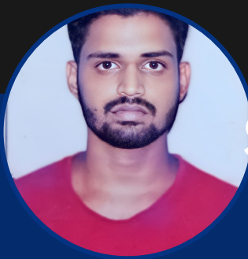
SUNKARA SANDEEP NAIDU
Senior software Engineer| Spring Boot Developer
Bachelor of computer science from PVP Siddhartha institute of Technology – 2019
Certification in GSDC – 2023
Aws certification
Certification in sql.
Certification in unix
sunkara-sandeep.naidu@capgemini.com
6281488738
Bangalore
Hindi, English , Telugu
An ambitious and dedicated individual eager to launch a career as a Spring Boot Developer, with a solid foundation in Spring Boot and related technologies.
As a Spring boot fresher, I am enthusiastic about the opportunity to collaborate with team members, contribute to innovative projects, and drive continuous improvement in operational efficiency. I am eager to learn from experienced professionals and make a meaningful impact.
2023 - Present: Capgemini
Frontend: | React, Tailwind CSS
Backend: | Java , Spring Boot, Spring Data JPA, REST API, OOPs, Junit , Web services , SQL
Key areas | Programming, Problem Solving, Debugging
Cloud: | Unix, AWS, Docker,Jenkins, Git, Terraform , Python Scripting

Slide 2
Assignments
Project Name - 1 | AirLines Ticket Booking Application using Spring Boot and React
Client | self
Role | Java Developer
Roles performed | Key Responsibilities : Developed a full-stack ticket booking application with a React frontend and Spring Boot backend. Implemented user-friendly React components for booking tickets, viewing available seats, and payment processing. Designed and developed RESTful APIs in Spring Boot to handle booking requests, and ticket management. Integrated backend with a postgreSQL database for storing user details, ticket information, and booking history. Ensured seamless interaction between the frontend and backend through axios for efficient API communication. Optimized application performance and ensured smooth user experience across platforms.
Technology used in project | Spring boot,Spring data Jpa,Rest api
 | React
 | Git
Description | Developed a full-stack ticket booking application with a React frontend and Spring Boot backend. Created RESTful APIs for managing bookings and integrated PostgreSQL for data storage. Optimized performance and ensured seamless frontend-backend communication using axios.

Slide 3
Assignments
Project Name - 2 | Django Application for CI/CD Automation with Jenkins, SonarQube, and AWS Deployment(GENGARAGE)
Client | GEN GARAGE
Role | DevOps Engineer
Roles performed | Key responsibilities: Developed a Django-based web application that collects GitHub repository URLs from a user input form. Integrated Jenkins to trigger jobs upon form submission, automating CI/CD pipelines. Configured Jenkins jobs to perform the following: Retrieve code from GitHub based on the provided URLs. Run SonarQube for static code analysis to identify code defects and quality issues. Execute Terraform scripts to provision and deploy the application on AWS infrastructure. Ensured seamless deployment and infrastructure management using Infrastructure as Code (IaC) practices via Terraform. Optimized the workflow for continuous integration, testing, and deployment.
Technology used in project | Django
 | AWS
 | JENKINS
Description | Developed a Django-based web application to trigger Jenkins jobs for automated CI/CD, retrieving code from GitHub repositories. Integrated SonarQube for static code analysis and Terraform for AWS deployment using Infrastructure as Code (IaC) practices. Optimized continuous integration, testing, and deployment workflows.

